Slide 1
Team: Health Inspections
Ryan Permenter, Rachel Podemski, Clarence Robinson & Brett Thompson

Slide 2
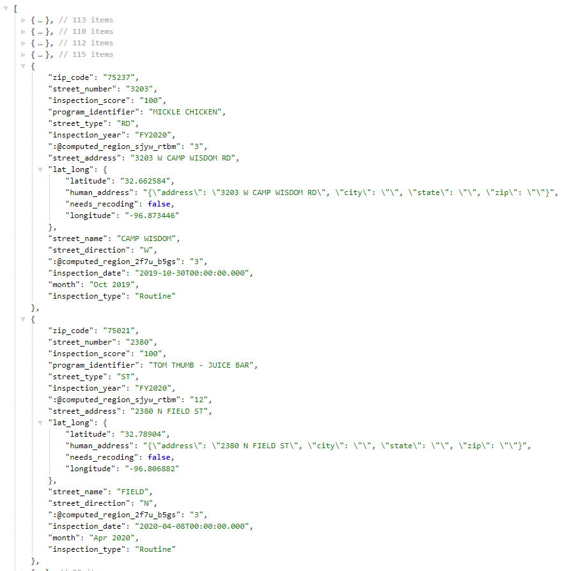
INTRODUCTION
Our dataset contains details of over 50,000 health inspections and scores in the greater Dallas area dating back to October 2016.
The data is intended to communicate the following:
Name of Establishment
Physical Location
Overall Inspection Score
Point deduction of individual violations
The data is provided by the Dallas Code Compliance Services Department and is updated monthly.

Slide 3
MOTIVATION
Dataset: Hungry at the time
Colors: Red & Yellow stimulate appetite
Worst places to eat locally
Best places to eat locally

Slide 4
METHODOLOGY
Map
Bar Chart
Line Graph
Scatter Plot

Slide 5
CONCLUSIONS
Conclusion #1 – Map
Conclusion #2 – Bar
Conclusion #3 – Line
Conclusion #4 – Scatter
The food establishments at the intersection of Knox Street & IH-75 have had consistently lower health inspection scores compared to the greater Dallas area for the past 4-years.
The food establishments to the Northwest of Dallas Love Field also tend to have lower inspections scores in the past 4-years.
Taking a sample size of 5,000 data points, on average most zip codes have an inspection score equal to or greater than 90.
When looking at the reason for the inspection, if the inspection occurred because of a Complaint, they tend to have a higher average inspection score than a Routine or Follow-Up inspection.
A lower inspection score usually resulted in a higher score during the Follow-Up inspection.
Violations and inspection score are inversely correlated. Meaning the more violations, a restaurant has, the lower overall inspection will be.

